Slide 2
Component 1 - 3D Design
Level 5

Slide 3
Candidate 1
3D Design - Level 5
AO1 | AO2 | AO3 | AO4 | Total
15 | 15 | 14 | 15 | 59
Examiner comment:
AO1: Fully confident and assured ability – Level 5
AO2: Fully confident and assured ability – Level 5
AO3: Mostly confident and assured ability – Level 5
AO4: Fully confident and assured ability – Level 5
Total of 59 marks overall.

Slide 4
59 marks

Slide 5
59 marks

Slide 6
59 marks

Slide 7
59 marks

Slide 8
59 marks

Slide 9
59 marks

Slide 10
59 marks

Slide 11
59 marks

Slide 12
59 marks

Slide 13
59 marks

Slide 14
59 marks

Slide 15
59 marks

Slide 16
59 marks

Slide 17
59 marks

Slide 18
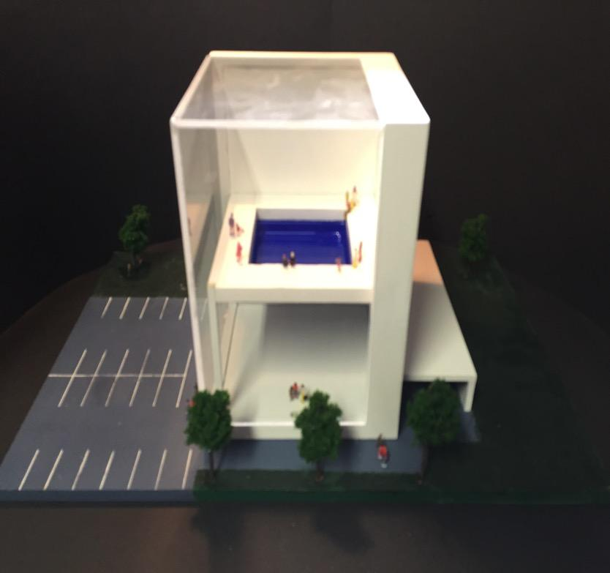
59 marks

Slide 19
59 marks

Slide 20
59 marks

Slide 21
59 marks

Slide 22
59 marks

Slide 23
59 marks

Slide 24
59 marks

Slide 25
59 marks

Slide 26
59
59 marks

Slide 27
59 marks

Slide 28
59
59 marks

Slide 29
59 marks

Slide 30
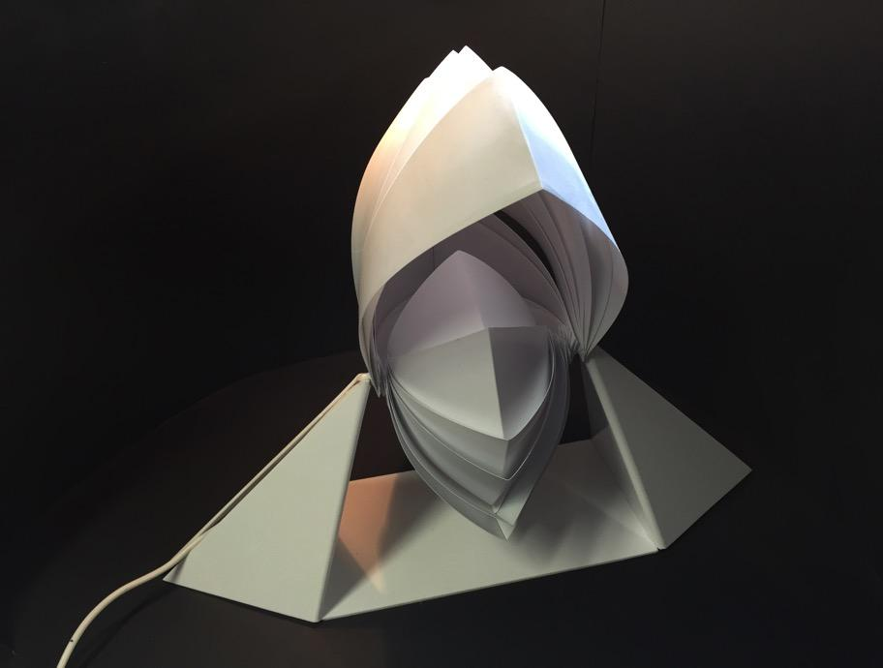
59 marks

Slide 31
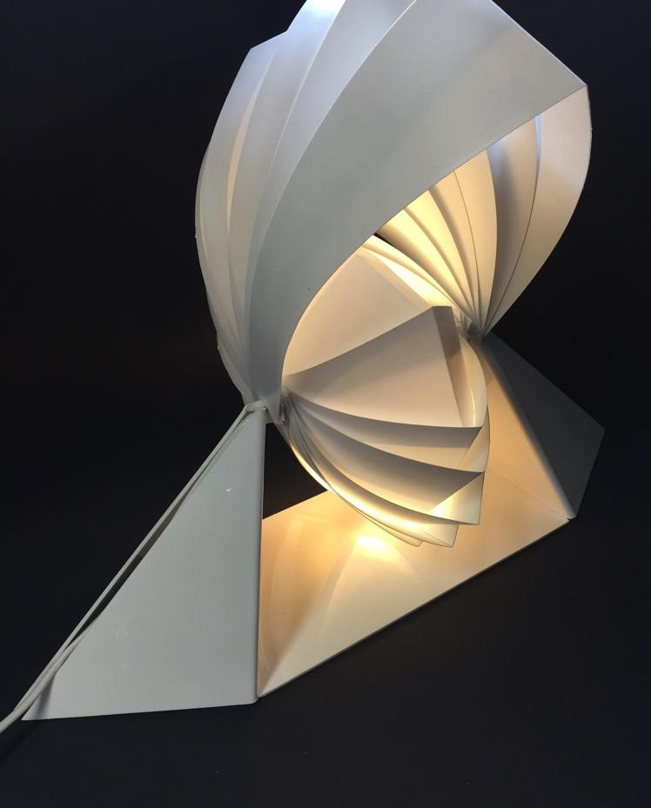
59 marks

Slide 32
59 marks

