Slide 2
Component 1 – Art & Design
Level 1

Slide 3
Candidate 6 Art and Design – Level 1
AO1 | AO2 | AO3 | AO4 | Total
2 | 2 | 2 | 2 | 8
Examiner comment:
AO1: Mostly limited ability – Level 1
AO2: Mostly limited ability – Level 1
AO3: Mostly limited ability – Level 1
AO4: Mostly limited ability – Level 1
Total of 8 marks overall.

Slide 4
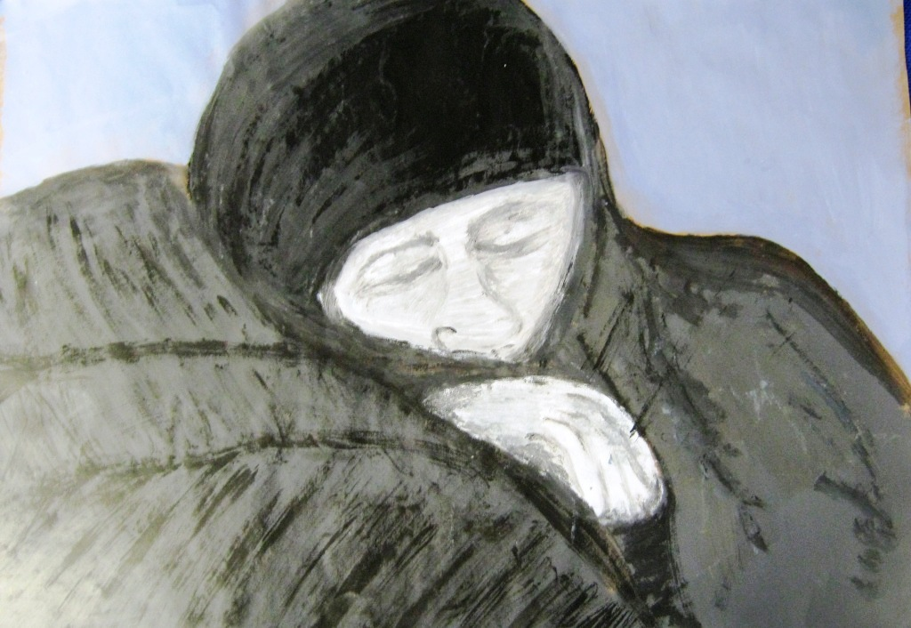
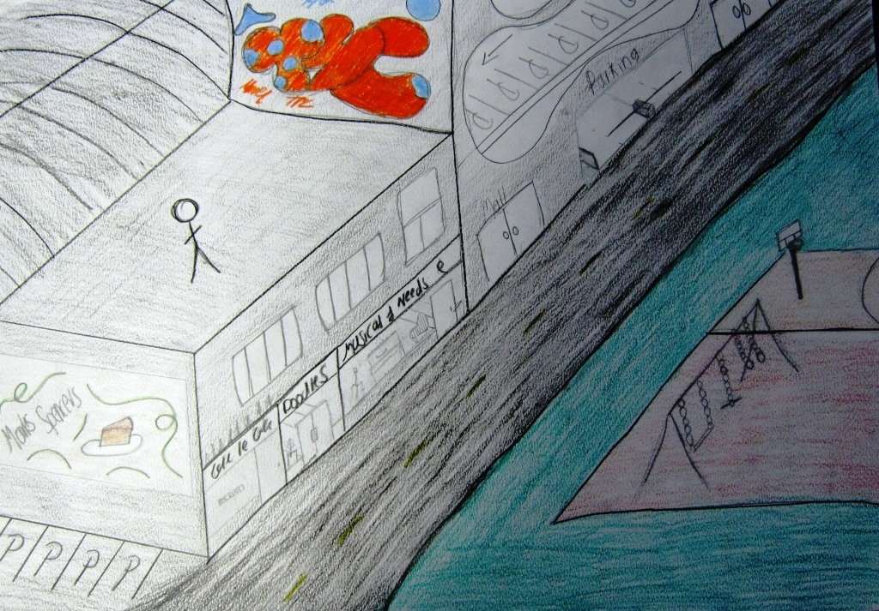
8 marks

Slide 5
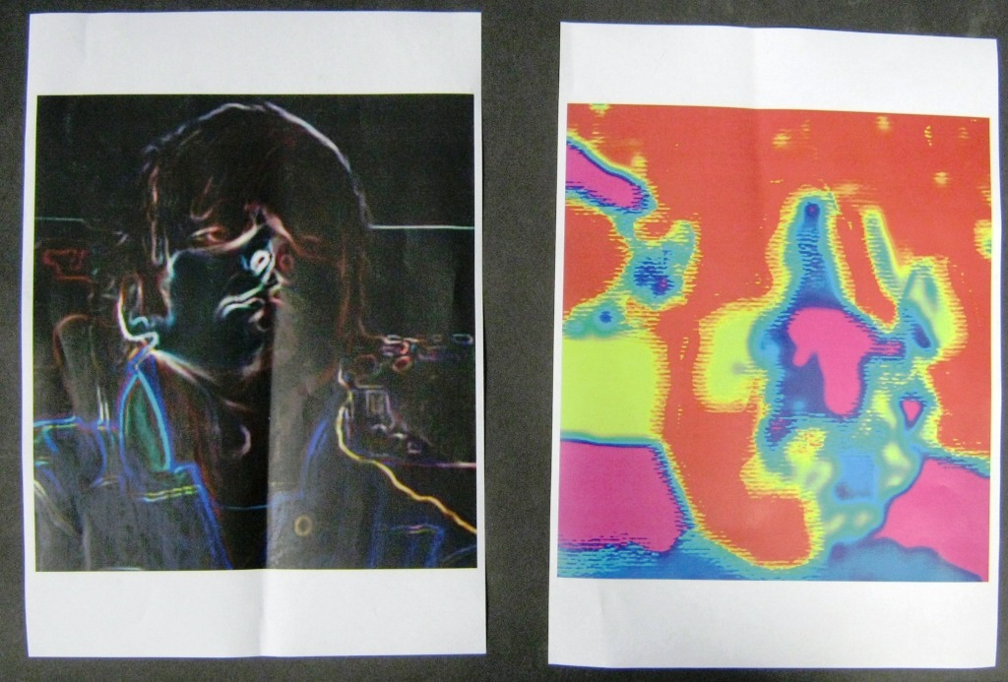
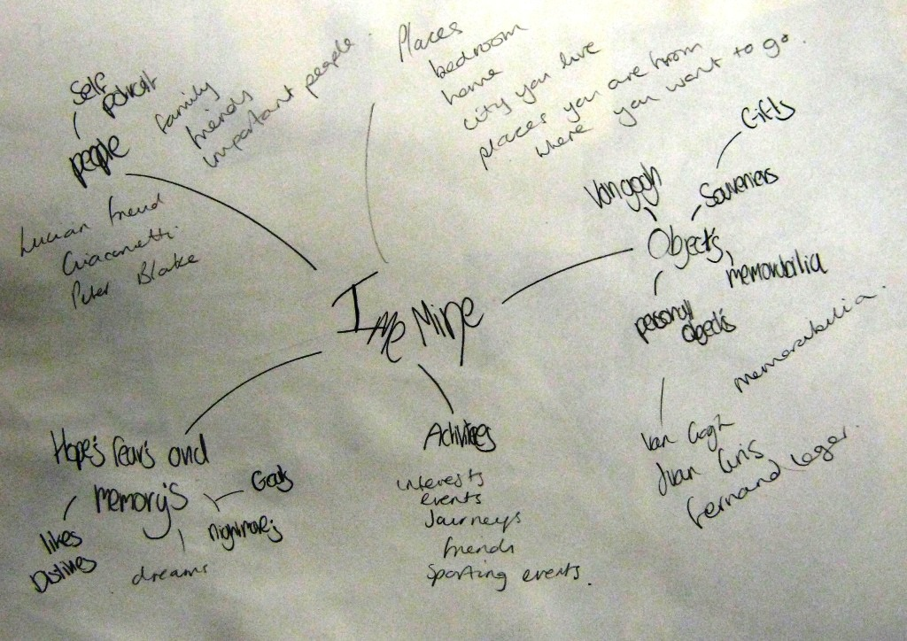
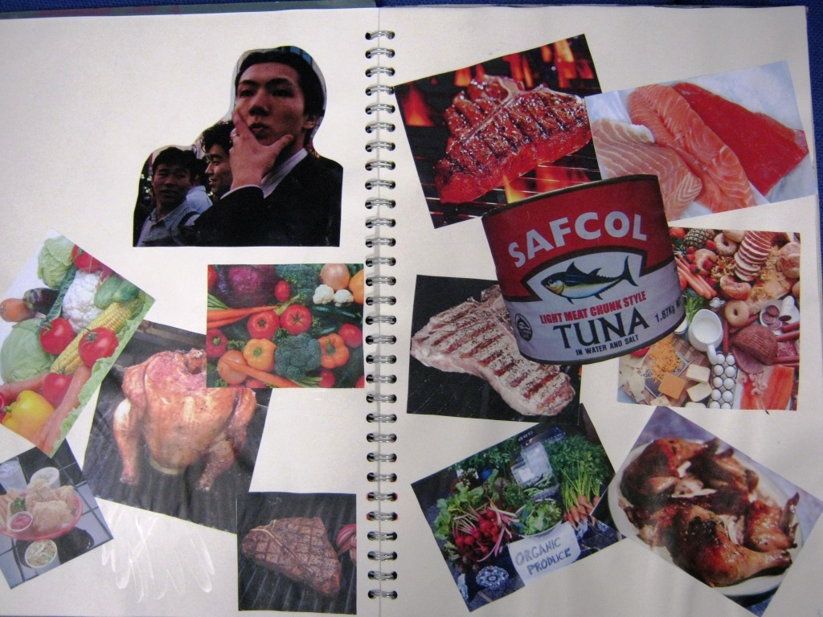
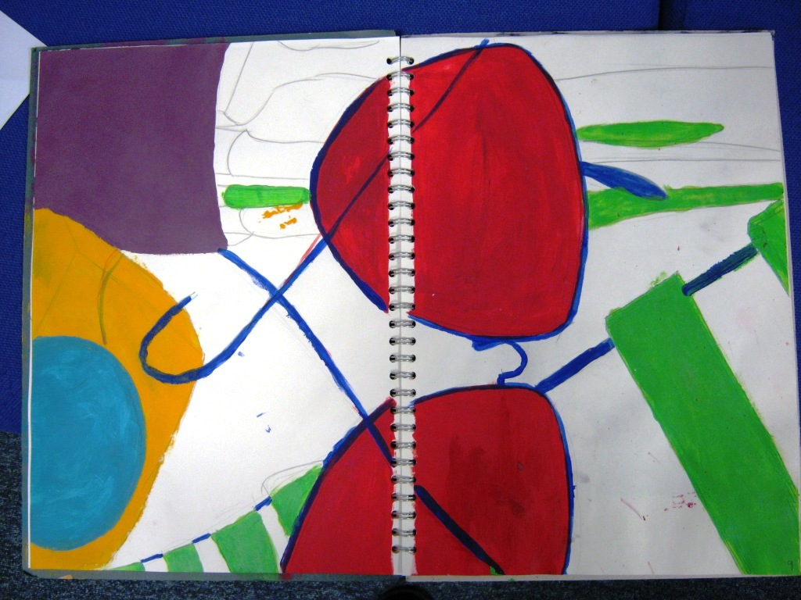
8 marks

Slide 6
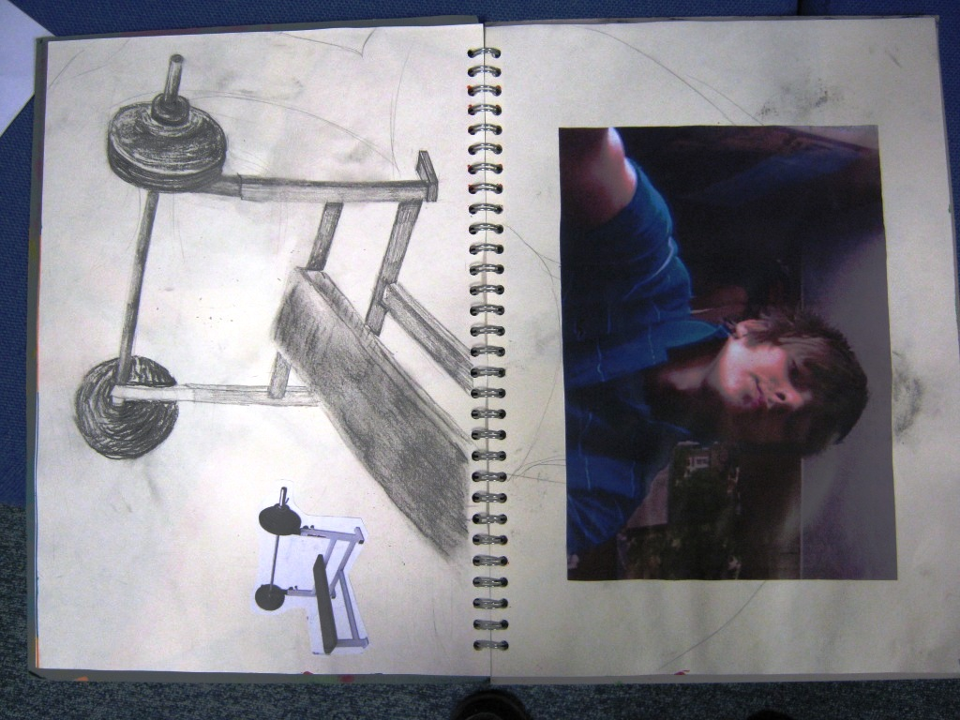
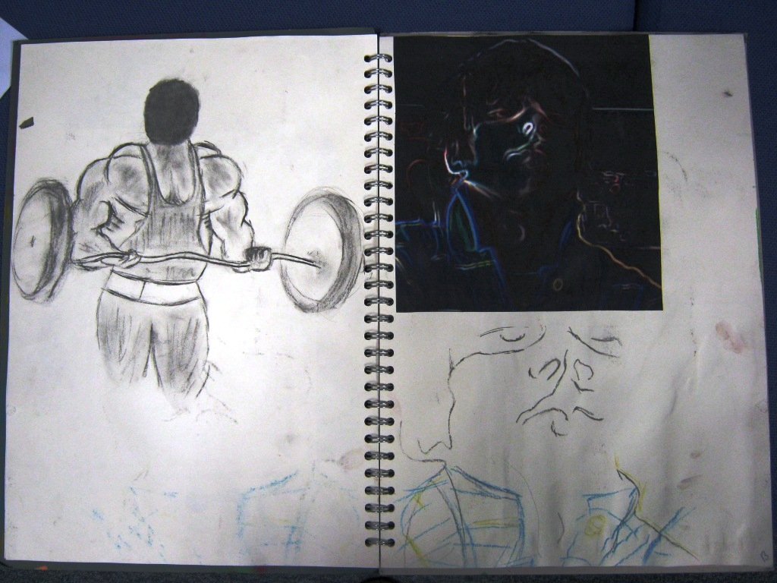
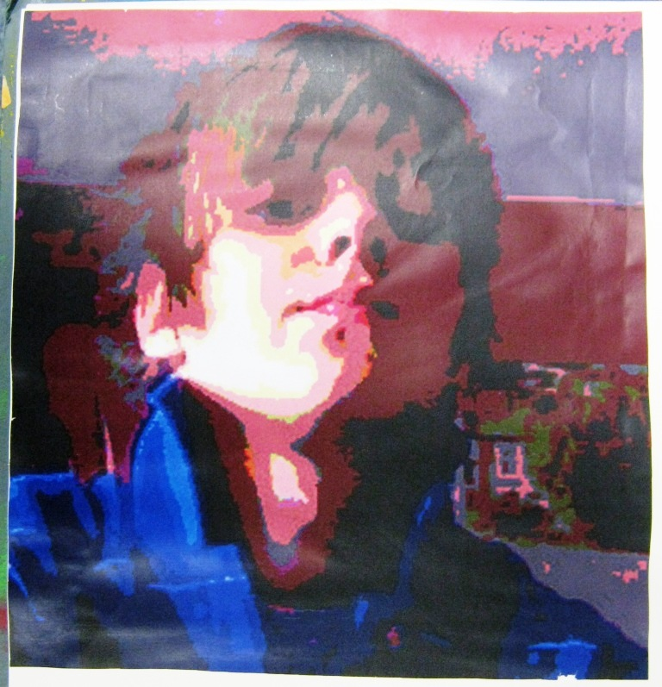
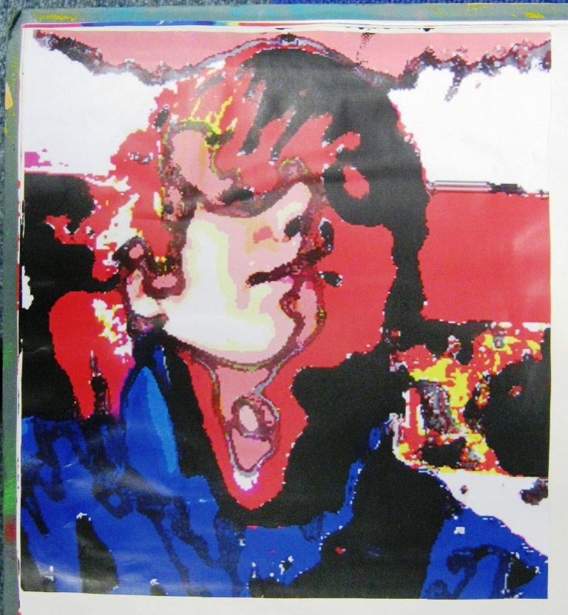
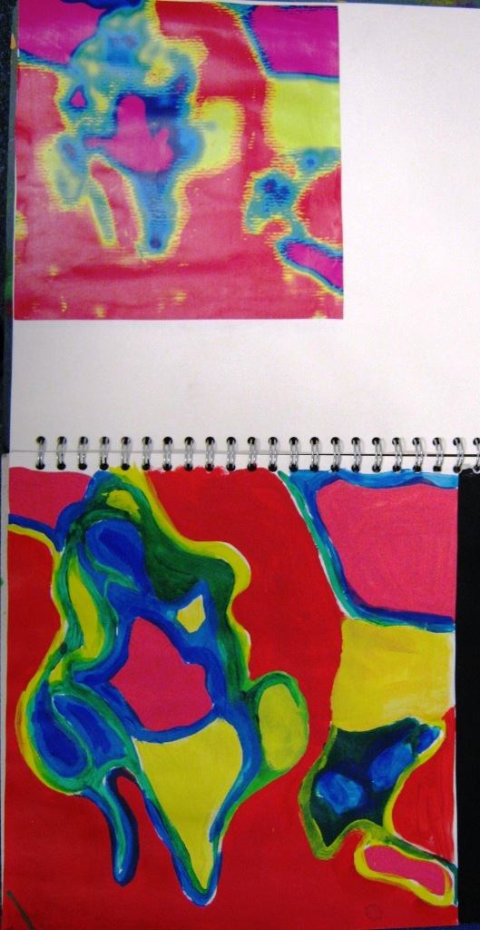
8 marks

Slide 7
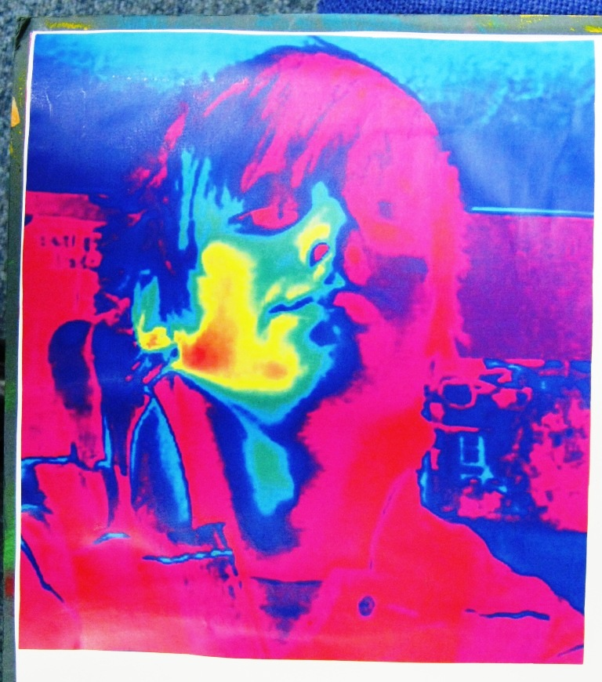
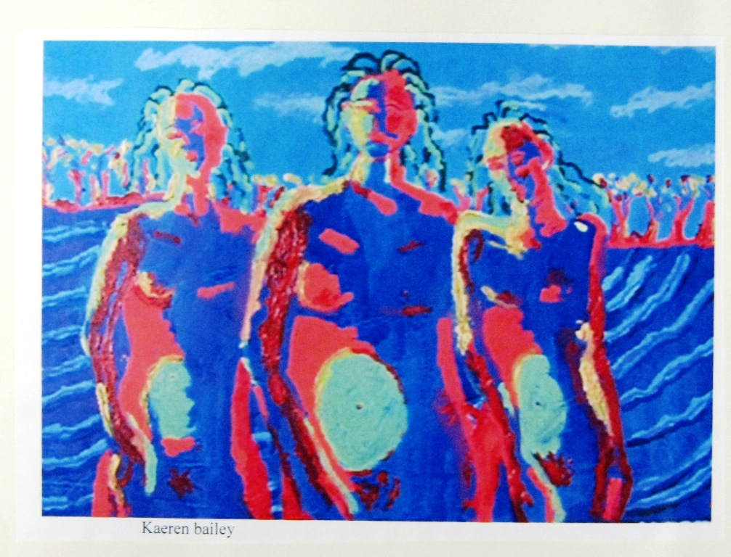
8 marks

Slide 8
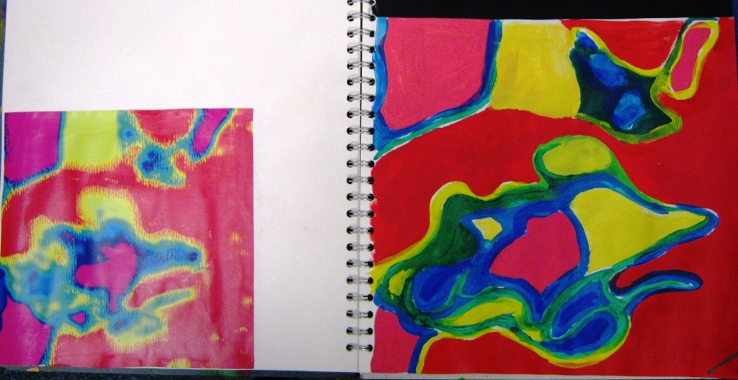
8 marks

