Slide 2
Component 1 – Graphic Communication
Level 3

Slide 3
Candidate 3 Graphic Communication – Level 3
AO1 | AO2 | AO3 | AO4 | Total
9 | 10 | 9 | 10 | 38
Examiner comment:
AO1: Fully emerging competent ability – Level 3
AO2: Just competent and consistent ability – Level 4
AO3: Fully emerging competent ability – Level 3
AO4:Just competent and consistent ability – Level 4
Total of 38 marks overall.

Slide 4
38 marks

Slide 5
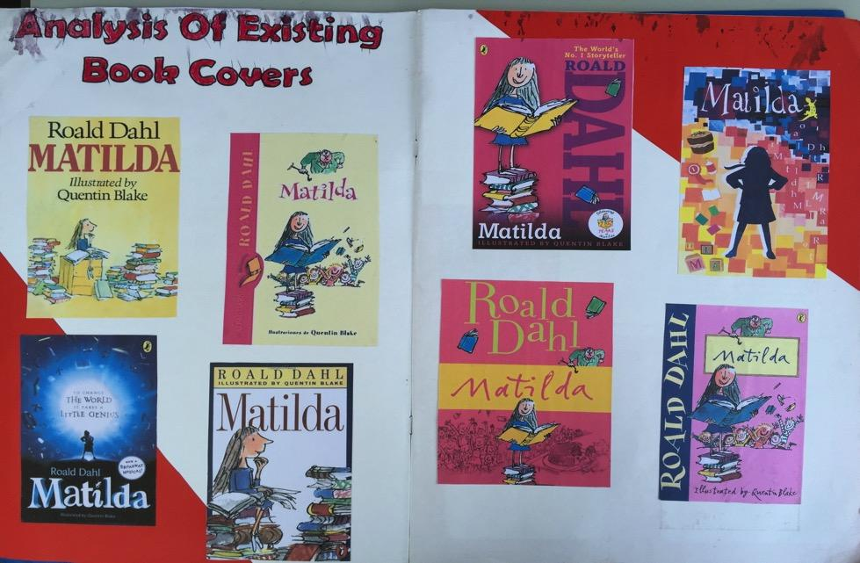
38 marks

Slide 6
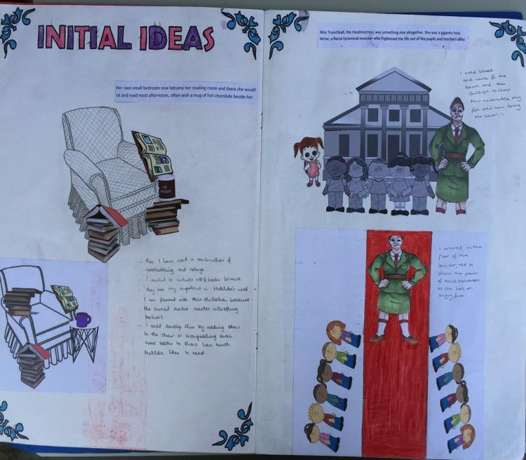
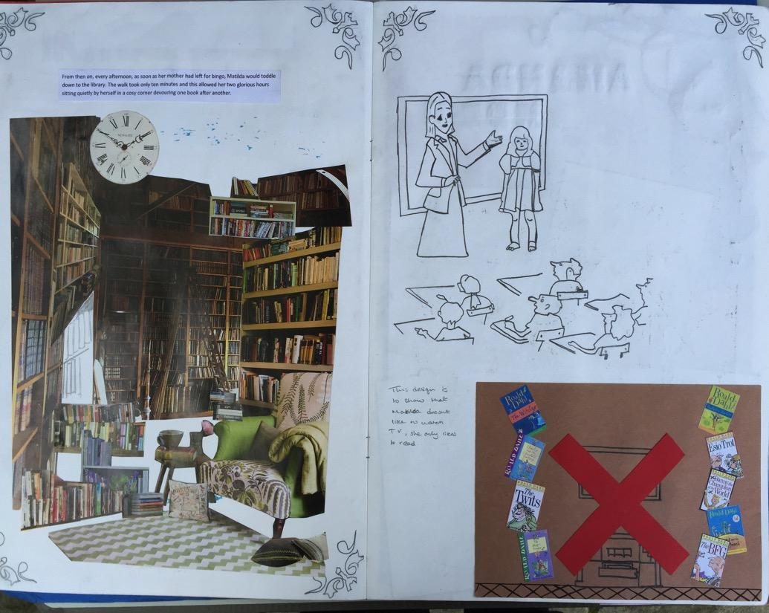
38 marks

Slide 7
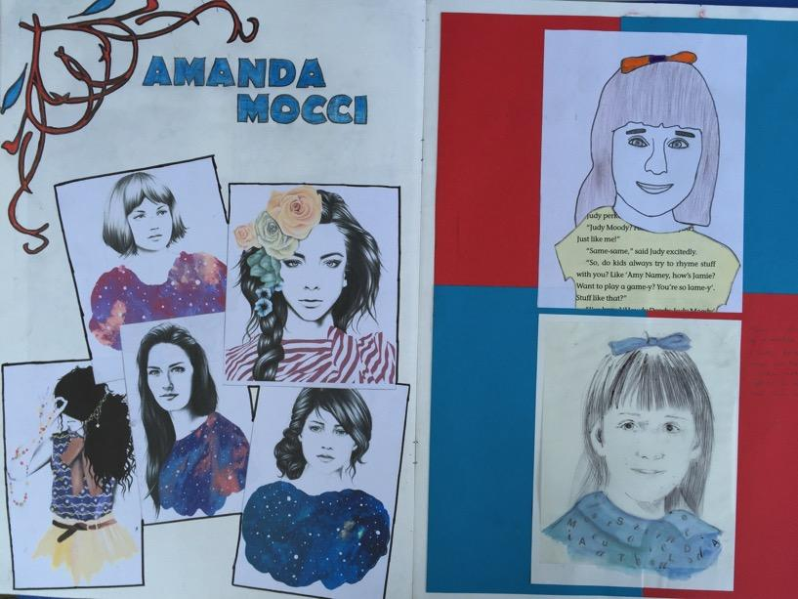
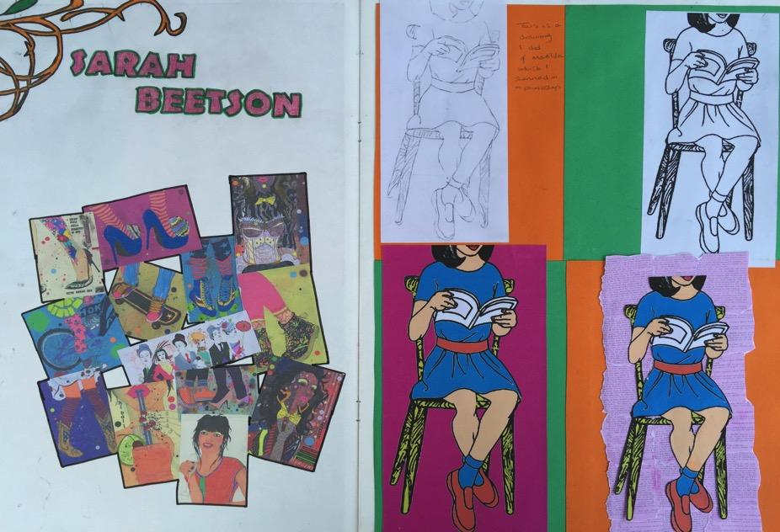
38 marks

Slide 8
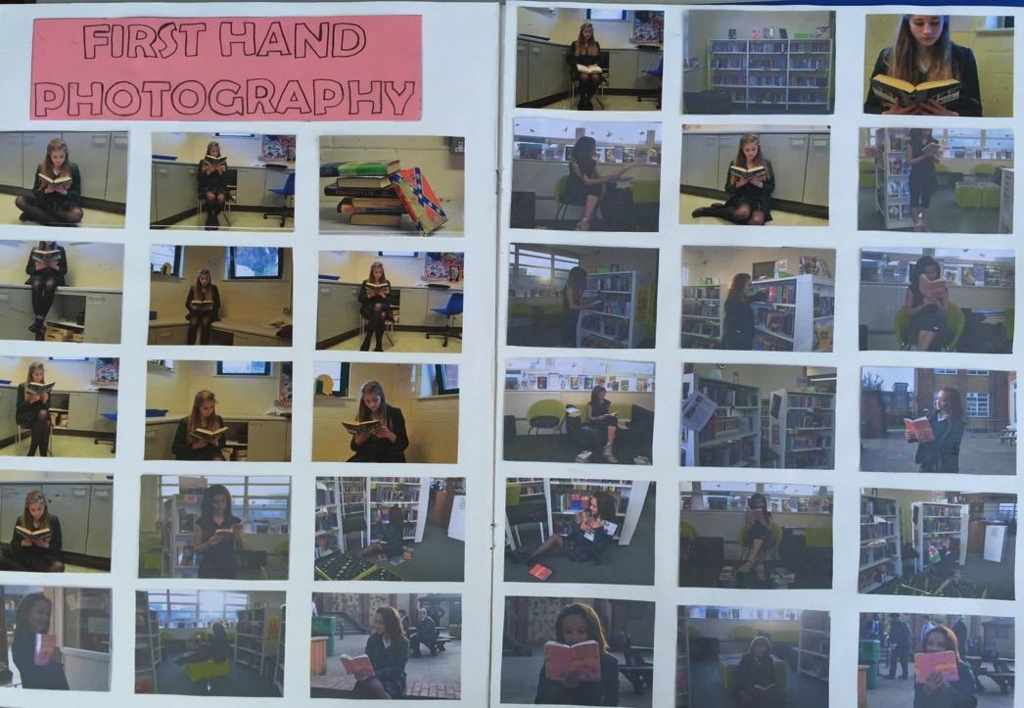
38 marks

Slide 9
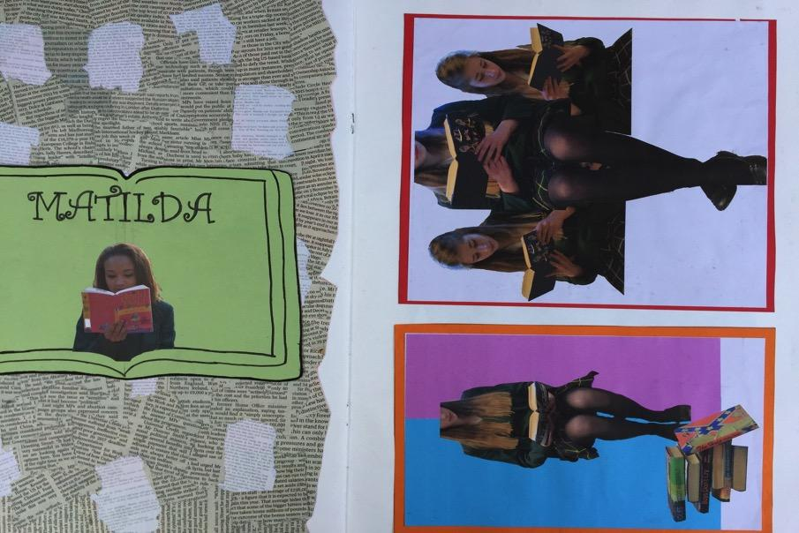
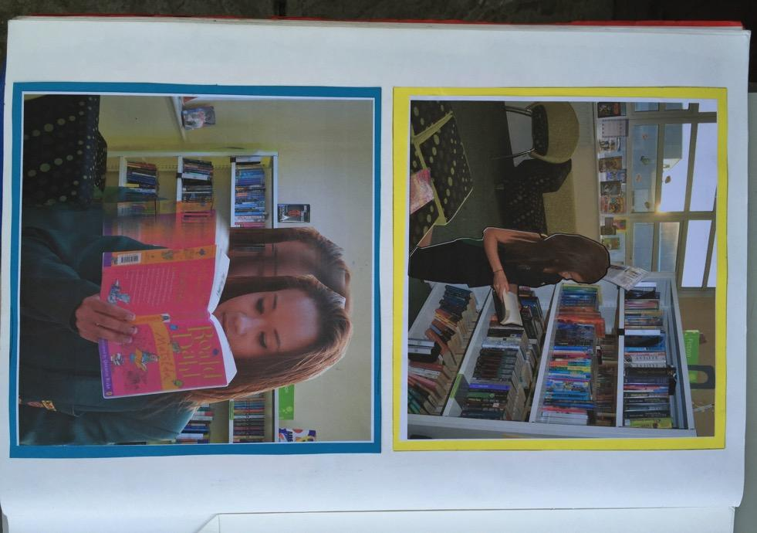
38 marks

Slide 10
38 marks

Slide 11
38 marks

Slide 12
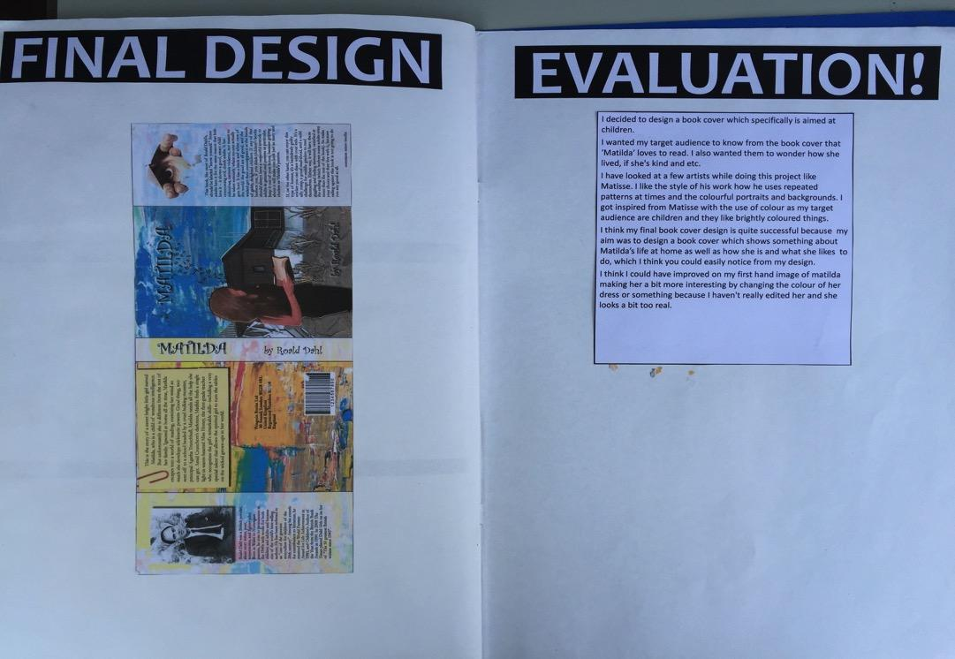
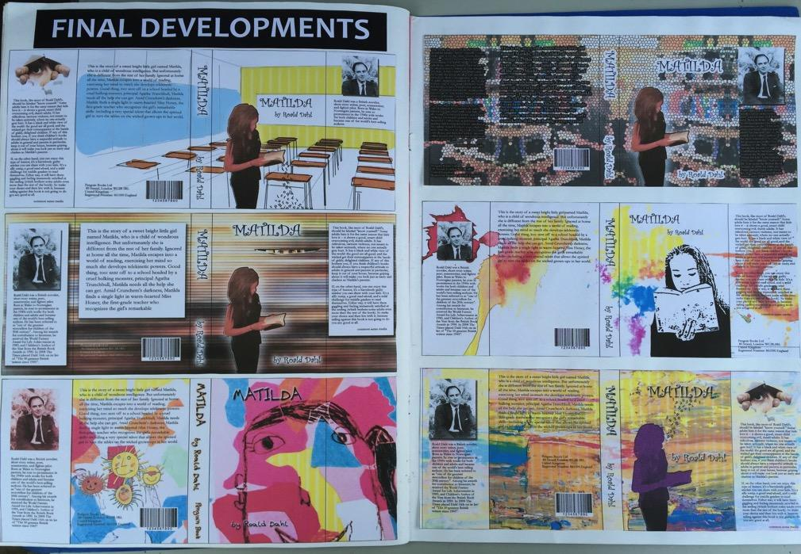
38 marks

Slide 13
38 marks

Slide 14
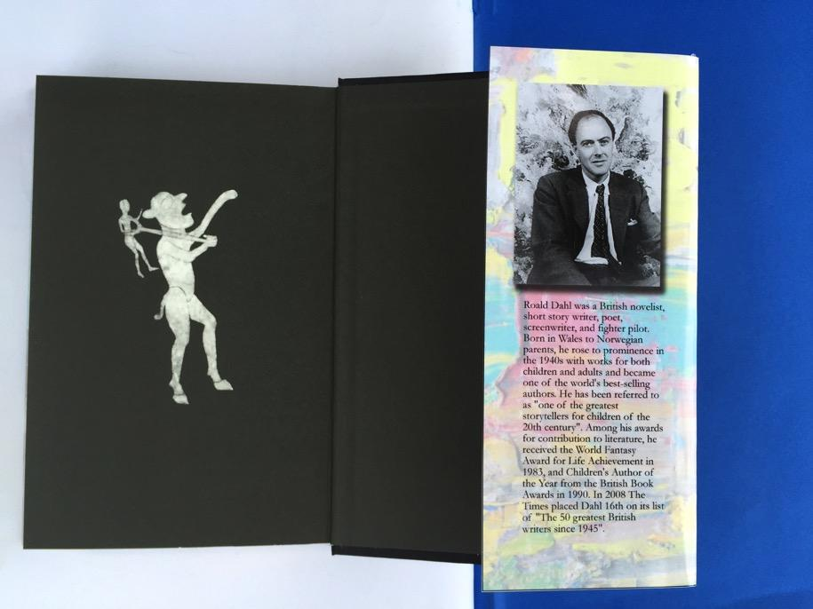
38 marks

Slide 15
38 marks

Slide 16
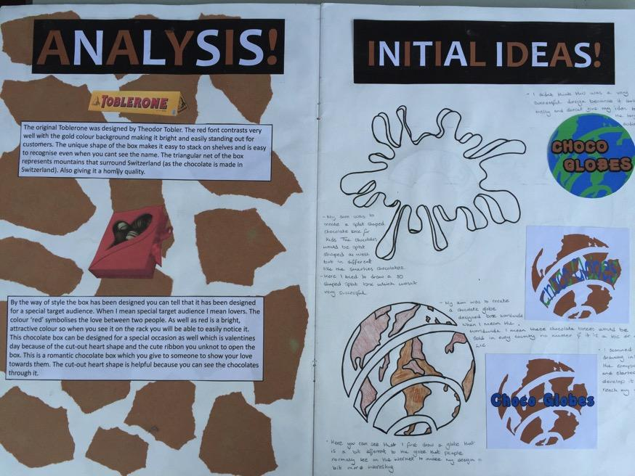
38 marks

Slide 17
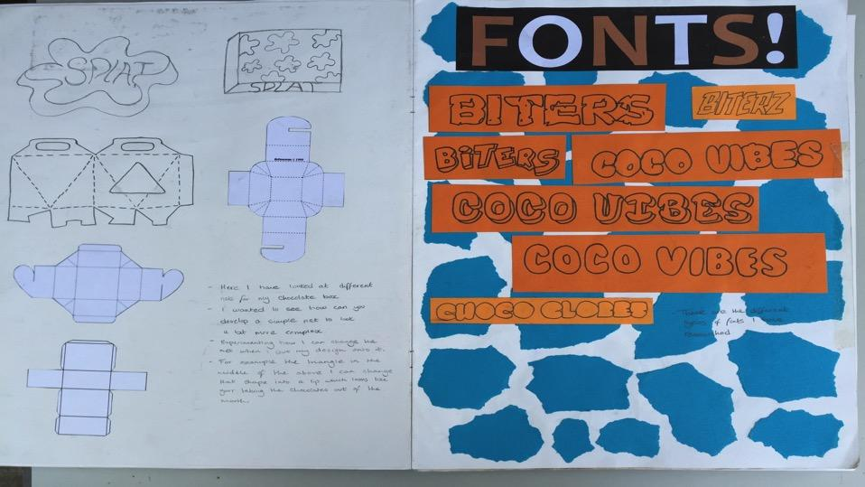
38 marks

Slide 18
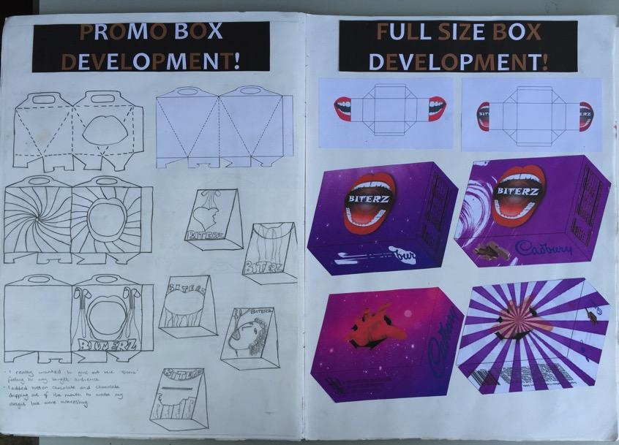
38 marks

Slide 19
38 marks

Slide 20
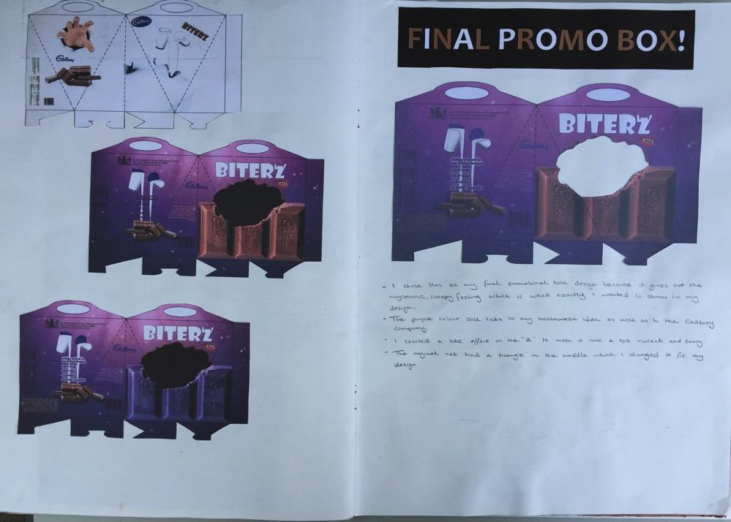
38 marks

Slide 21
38 marks

Slide 22
38 marks

Slide 23
38 marks

Slide 24
38 marks

Slide 25
38 marks

Slide 26
38 marks

Slide 27
38 marks

Slide 28
38 marks

