Slide 1
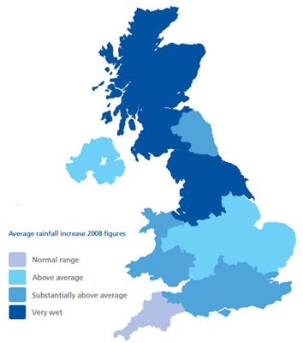
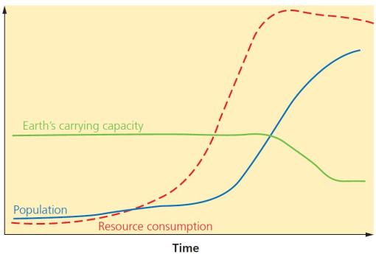
Resource Challenges
Resources are things that humans require for life or to make our lives easier. Humans are becoming increasingly dependent on exploiting these resources, and as a result they are in high demand.
Food in the UK
Growing Demand | Impact of Demand
The UK imports about 40% of its food. This increases people’s carbon footprint. There is growing demand for greater choice of exotic foods needed all year round. Foods from abroad are more affordable. Many food types are unsuitable to be grown in the UK. | Foods can travel long distances (food miles). Importing food adds to our carbon footprint. + Supports workers with an income + Supports families in LICs. + Taxes from farmers’ incomes contribute to local services. - Less land for locals to grow their own food. - Farmers exposed to chemicals.
Agribusiness | Sustainable Foods
Farming is being treated like a large industrial business. This is increasing food production. + Intensive faming maximises the amount of food produced. + Using machinery which increases the farms efficiency. - Only employs a small number of workers. - Chemicals used on farms damages the habitats and wildlife. | Organic foods that have little impact on the environment and are healthier have been rising. Local food sourcing is also rising in popularity. Reduces emissions by only eating food from the UK. Buying locally sourced food supports local shops and farms. A third of people grow their own food.
Water in the UK
Growing Demand | Deficit and Surplus
The average water used per household has risen by 70%. This growing demand is predicted to increase by 5% by 2020. This is due to: A growing UK population. Water-intensive appliances. Showers and baths taken. Industrial and leisure use. Watering greenhouses. | The north and west have a water surplus (more water than is required). The south and east have a water deficit (more water needed than is actually available). More than half of England is experiencing water stress (where demand exceeds supply).
Pollution and Quality | Water stress in the UK
Cause and effects include: Chemical run-off from farmland can destroy habitats and kills animals. Oil from boats and ships poisons wildlife. Untreated waste from industries creates unsafe drinking water. Sewage containing bacteria spreads infectious diseases.
Management | Water Transfer
UK has strict laws that limits the amount of discharge from factories and farms. Education campaigns to inform what can be disposed of safety. Waste water treatment plants remove dangerous elements to then be used for safe drinking. Pollution traps catch and filter pollutants. | Water transfer involves moving water through pipes from areas of surplus (Wales) to areas of deficit (London). Opposition includes: Effects on land and wildlife. High maintenance costs. The amount of energy required to move water over long distances.
Significance of Water
Resources such as food, energy and water are what is needed for basic human development.
FOOD | WATER | ENERGY
Without enough nutritious food, people can become malnourished. This can make them ill . This can prevent people working or receiving education. | People need a supply of clean and safe water for drinking, cooking and washing. Water is also needed for food, clothes and other products. | A good supply of energy is needed for a basic standard of living. People need light and heat for cooking or to stay warm. It is also needed for industry.
Demand outstripping supply
The demand for resources like food, water and energy is rising so quickly that supply cannot always keep up. Importantly, access to these resources vary dramatically in different locations
1. Population Growth | 2. Economic Development
Currently the global population is 7.3 billion. Global population has risen exponentially this century. Global population is expected to reach 9 billion by 2050. With more people, the demand for food, water, energy, jobs and space will increase. | As LICs and NEEs develop further, they require more energy for industry. LICs and NEEs want similar lifestyles to HICs, therefore they will need to consume more resources. Development means more water is required for food production as diets improve.
 | Resource Reliance Graph
 | Consumption – The act of using up resources or purchasing goods and produce. Carry Capacity – A maximum number of species that can be supported.
 | Resource consumption exceeds Earth’s ability to provide!
3. Changing Technology and Employment
The demand for resources has driven the need for new technology to reach or gain more resources. More people in the secondary and tertiary industry has increased the demand for resources required for electronics and robotics.
Unit 2c
The Challenge of Resource Management
Energy in the UK
Growing Demand | Energy Mix
The UK consumes less energy than compared to the 1970s despite a smaller population. This is due to the decline of industry. | The majority of UK’s energy mix comes from fossil fuels. By 2020, the UK aims for 15% of its energy to come from renewable sources. These renewable sources do not contribute to climate change.
Changes in Energy Mix
75% of the UK’s oil and gas has been used up. Coal consumption has declined. UK has become too dependent on imported energy.
Energy in the UK (continued)
Significance of Renewables | Exploitation
+ The UK government is investing more into low carbon alternatives. + UK government aims to meet targets for reducing emissions. + Renewable sources include wind, solar and tidal energy. - Although infinite, renewables are still expensive to install. - Shale gas deposits may be exploited in the near future | Nuclear | New plants provide job opportunities. Problems with safety and possible harm to wildlife. Nuclear plants are expensive.
 | Wind Farm | Locals have low energy bills. Reduces carbon footprint. Construction cost is high. Visual impacts on landscape. Noise from wind turbines.
2009
2020
 | Oil |  | Gas |  | Renewable
 | Nuclear |  | Coal |  | Other

Slide 2
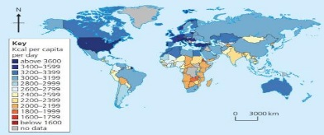
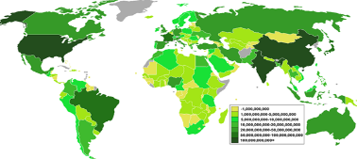
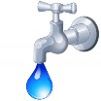
Option 1: FOOD
Option 2: WATER
Option 3: ENERGY
Food Security is when people at all times need to have physical & economic access to food to meet their dietary needs for an active & healthy life. This is the opposite to Food Insecurity which is when someone is unsure when they might next eat.
Human | Physical
Poverty prevents people affording food and buying equipment. Conflict disrupts farming and prevents supplies. Food waste due to poor transport and storage. Climate Change is affecting rainfall patterns making food production difficult. | The quality of soil is important to ensure crops have key nutrients. Water supply needs to be reliable to allow food to grow. Pest, diseases and parasites can destroy vast amounts of crops that are necessary to populations. Extreme weather events can damage crops (i.e. floods).
Water security is when people have good access to enough clean water to sustain well-being and good health. Water insecurity is when areas are without sufficient water supplies. Water Stress is when less than 1700m³ is available per person.
Human | Physical
Pollution caused from human and industrial waste being dumped into peoples water sources. Poverty prevents low income families affording water. Limited infrastructure such as a lack of water pipes and sewers. Over-abstraction is when more water is taken than is replaced. | Climate needs to provide enough rainfall to feed lakes and rivers. Droughts affect supply if water. Geology can affect accessibility to water. Permeable rock means sourcing water from difficult aquifers, whereas impermeable allows water to run-off into easily collected basins.
Energy security means having a reliable, uninterrupted and affordable supply of energy available. Energy insecurity can be experienced by countries with both a high and low energy consumption. Technology is increasing energy consumption.
Physical | Economic
Geology determines the availability of fossil fuels. Climate variations will affect the potential use of renewable energy. Natural disasters can damage energy infrastructure. | Cost of extracting fossil fuels is becoming costly and difficult. Price of fossil fuels are volatile to potential political changes. Infrastructure for energy is costly, especially for LICs.
Technology | Political
New technology is making once difficult energy sources now reachable/exploitable. | Conflict and turmoil in energy rich countries can affect exports. Stricter regulations over Nuclear.
Daily Calorie Intake
This map shows how many calories per person that are consumed on average for each country. This can indicate the global distribution of available food and food inequality.
Food Supply
This map shows the amount of food produced in different countries. Whilst Asia and North America have high production outputs, Africa and Central America have low production outputs.
Impact of Water Insecurity
Food production | Industrial output
The less water available for irrigating crops the less food that will be produced. This could lead to starvation. | Manufacturing industries depend heavily on water. A severe lack of water can impact economic output.
Disease and Water Pollution | Water conflict
Inadequate sanitation systems pollutes drinking water causing diseases such as cholera and typhoid. | Water sources that cross national borders can create tensions and even war between countries.
Impact of Energy Insecurity
Sensitive environments | Food production
Exploration of energy resources threatens to harm sensitive areas such as the oil drilling in Alaska, USA. | Food production depends on the energy needed to power machinery and transport goods to different markets.
Energy conflict | Industry
Shortages of energy resources can lead to tensions and violence. Conflict can be caused by fear of energy insecurity. | Countries can suffer from shortfalls in energy leading to a decline in manufacturing and services.
Increasing Food Supply
Hydroponics - A method of growing plants without soil. Instead they use nutrient solution. New Green Revolution - Aims to improve yields in a more sustainable way. Involves using both GM varieties and traditional and organic farming. Biotechnology - Genetically modified (GM) crops changes the DNA of foods to enhance productivity and properties. Irrigation - Artificially watering the land so crops can grow. Useful in dry areas to make crops more productive.
C.S. Thanet Earth
Located in Kent, the site involves four huge greenhouses using hydroponics.
Advantages Supports more than 500 jobs. Produces food all year round. Provides UK with food security.
Disadvantages Money generated mostly goes to large companies not community. Requires a lot of energy. Causes visual & light pollution.
Increasing Water Supply
Water diversion - Involves diverting water to be stored for longer periods. Often water is pumped underground to prevent evaporation. Dams and Reservoirs - Dams control flow and storage of water. Water is released during times of water deficit. Water transfer – includes schemes to move water from areas of surplus to areas of deficit. Desalination – Involves the extraction of salt from sea water to produce fresh drinking water.
C.S. Lesotho Highland Water Project
Lesotho is a highland country dependent on South Africa. Lesotho has water surplus due to high rainfall.
Advantages Provides 75% of Lesotho’s GDP. Provides water to areas of drought in South Africa.
Disadvantages Dams displaced 30,000 people. Destruction to key ecosystems. 40% lost through pipe leakages.
Increasing Energy Supply
Non-renewables Fossil Fuels - Conventional power stations can be made more efficient with carbon capture overcoming the environmental impacts. Nuclear - Once a nuclear plant is built it can provide a cheap and long-term dependable source of energy. Renewables Wind, Solar, Biomass - These are examples of environmentally friendly renewable sources that can’t run out but cost a lot to install.
C.S. UK Fracking
Fracking is used to extract natural gas trapped in underground shale rock. It is a method considered by the UK.
Advantages Estimated to create 64,000 jobs. UK has large shale gas reserves. Is far cheaper than natural gas.
Disadvantages May cause groundwater pollution Is a non-renewable resource. May trigger minor earthquakes.
Sustainable Food Supply
This ensures that fertile soil, water and environmental resources are available for future generations.
Organic Farming - The banned use of chemicals and ensuring animals are raised naturally. Permaculture - People growing their own food and changing eating habits. Fewer resources are required. Urban Farming - Planting crops in urban areas. i.e. roundabouts. Managed Fishing – Includes setting catch limits, banning trawling and promoting pole and line methods.
C.S. NEE- Indus Basin Irrigation System
Largest irrigation scheme in the world. Involves large and small dams. Thousands of channels provides water to supports Pakistan’s rich farmlands.
Advantages Improves food security by adding 40% more land for farming. Increased yield & range of foods.
Disadvantages Few take an unfair share of water Water is wasted and demand is rising due to population growth. High cost to maintain reservoirs.
Sustainable Water Supply
Ensures water supplies don’t cause damage to the environment whilst also supporting the local economy.
Water conservation - Aims to reduce the amount of water wasted. Groundwater Management - Involves the monitoring of extracting groundwater. Laws can be introduced. Recycling and ‘Grey’ Water - Means taking water that has already been used and using it again rather than returning it to a river or the sea. This includes water taken from bathrooms and washing machines.
C.S. NEE - The Wakel River Basin
A project in India that aims to improve water use by encouraging greater use of rainwater harvesting techniques.
How does the project work? Provides ‘taankas’ that store water underground. Small dams called ‘johed’ interrupt water flow and encourages infiltration. Villages take turns to irrigate their fields so water is not overused. Maintained by farmers so it is entirely sustainable. Greater education for awareness.
Sustainable Energy Supply
This involves balancing supply & demand. It also includes reducing waste & supporting the environment.
Home design - Building homes to conserve energy. i.e. roof insulation. Reduce demand - Changing attitudes towards energy used to save energy. Efficient technology - Making cars more efficient by improving engine design and weight. i.e. Hybrid engines. Transport - Using public buses & bikes.
C.S. NEE - Chambamontera
Chambamontera is an isolated community in the Andes of Peru. It introduced a micro-hydro to exploit water power as an energy source.
Benefits to the community Provides renewable energy. Low maintenance & running costs Has little environmental impacts. Using local labour and materials. Businesses are developing. Less wood is needed to be burnt.

